Slide 1
GEZOND NAAR 100
Notes:
IF USING 3 MINUTE VIDEO
Thank you for watching the 3 minute introduction to Healthy Till 100. It’s an honor to be with you here today.
My name is Donna Ehrlich and my good friend Paul Jensen asked me to share the secrets of Healthy Till 100 and what has powered this simple and enjoyable life of living Healthy Till 100
We may not all live all the way to 100
but we can strive to live well as long as we do live….
radiating health
an abundant lifestyle
an unselfish heart
and a desire to serve
This presentation is for you, and how we can help you, meet YOUR goals...
to help you live an abundant life as long as you live.
NO 3 MINUTE PRESENTATION
It’s an honor to share with you the Healthy till 100 Lifestyle.
My name is Donna Ehrlich and our family is definitely living the Healthy till 100 Lifestyle
and we are loving it.
We may not all live all the way to 100
but we can strive to live well as long as we do live….
radiating health
an abundant lifestyle
an unselfish heart
and a desire to serve
This presentation is for you, and how we can help you, meet YOUR goals...
to help you live an abundant life as long as you live.

Slide 2
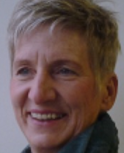
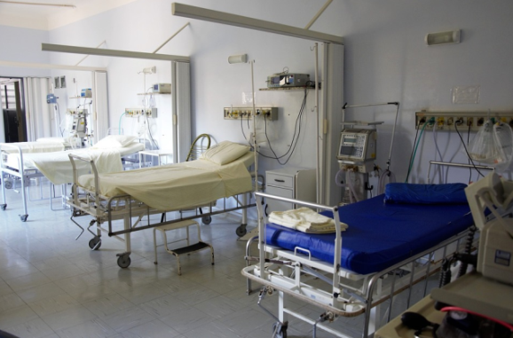
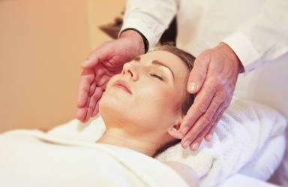
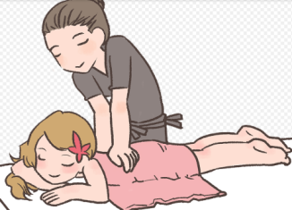
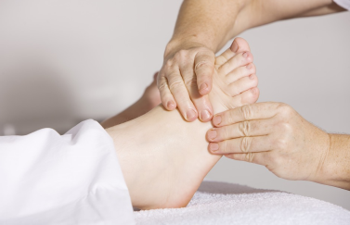
INTRODUCTIE MARGA VLAAR

Slide 3
BASISPAKKET: 5 PRODUCTEN

Slide 4
MIJN ERVARING

Slide 5
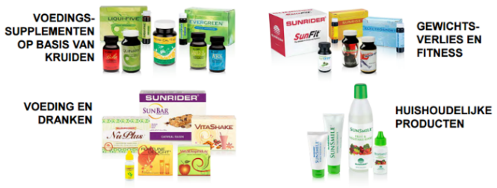
www.productsforlifechange.com
Sunrider® Producten

Slide 6
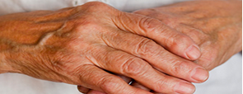
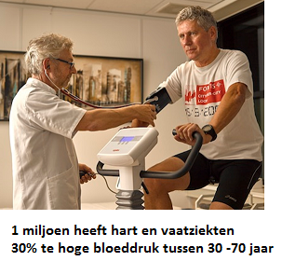
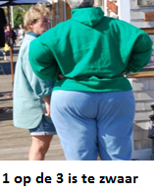
CHRONISCH ZIEK: 50%

Slide 7
VOEDSELKWALITEIT…
Minder vitaminen, sporenelementen en mineralen in groente en fruit!
Een vergelijking tussen een in 1985 en in 1996 ingesteld onderzoek in een onafhankelijk levensmiddelenlaboratorium in Karlsruhe naar de gemiddelde waarden in groente en fruit. (gepubliceerd in de Bielerfelder Tageszeitung “Westfälische Nachrichten”) Oorzaak: Uitgeputte grond, luchtvervuiling, te snelle groei, langdurig opslag, transport enz.
Bron: 1985 Farmaceutische bedrijf Geigy (Zwitserland). 1996 Levensmiddelen Laboratorium Karsruhe / Santorium Obertal en 2002

Slide 8
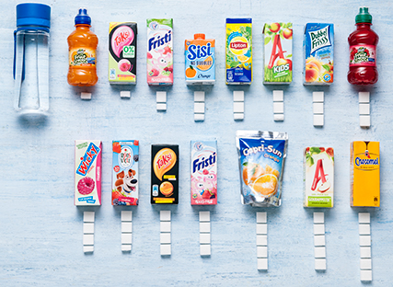
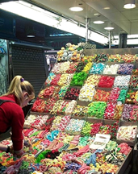
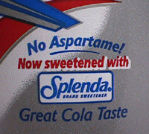
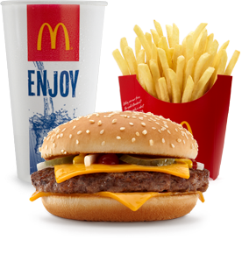
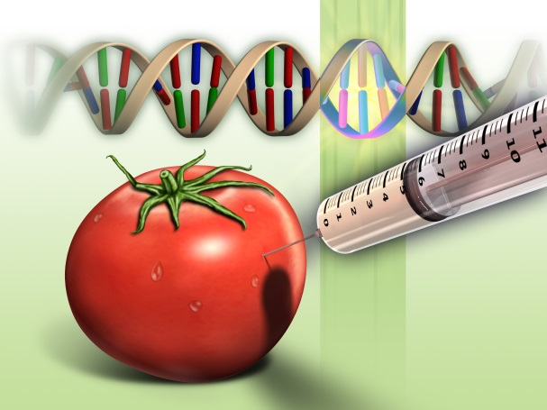
VOEDSELKWALITEIT…

Slide 9
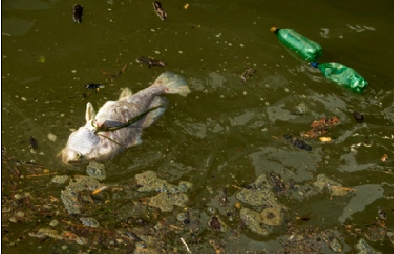
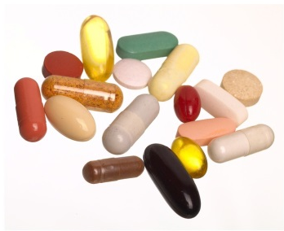
ANDERE OORZAKEN…

Slide 10
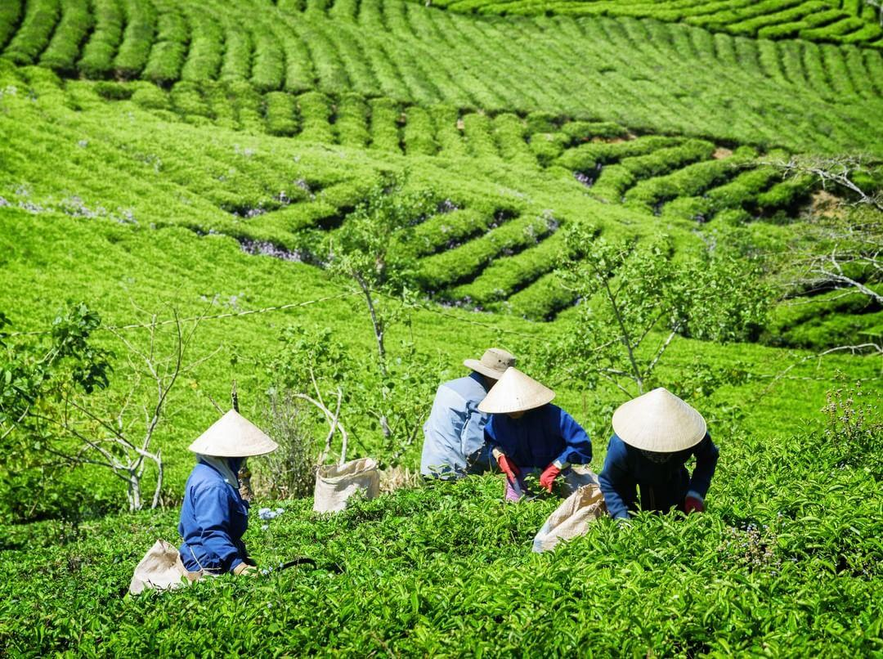
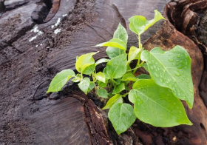
FILOSOFIE VAN REGENEREREN
Blauwdruk van elk Sunrider product:
Voedt en reinig je lichaam met de juiste combinatie van heel voedsel, waardoor je lichaam in balans komt en blijft.
Notes:
Vergelijk het met 5 paarden die een kar trekken. De 5 paarden staan voor de 5 belangrijkste systemen.
Als één paard te hard of te zacht rent, dan heeft dat effect op de andere paarden en de kar raakt uit balans. De kar rijdt zonder problemen als alle paarden in harmonie met elkaar lopen. Zo is het ook met ons lichaam, dat is gezond als alle 5 systemen in balans zijn.

Slide 11
FILOSOFIE VAN REGENEREREN
Dus: geen ziektes genezen, maar het lichaam optimaal gezond houden en balans bevorderen
Notes:
Vergelijk het met 5 paarden die een kar trekken. De 5 paarden staan voor de 5 belangrijkste systemen.
Als één paard te hard of te zacht rent, dan heeft dat effect op de andere paarden en de kar raakt uit balans. De kar rijdt zonder problemen als alle paarden in harmonie met elkaar lopen. Zo is het ook met ons lichaam, dat is gezond als alle 5 systemen in balans zijn.

Slide 12
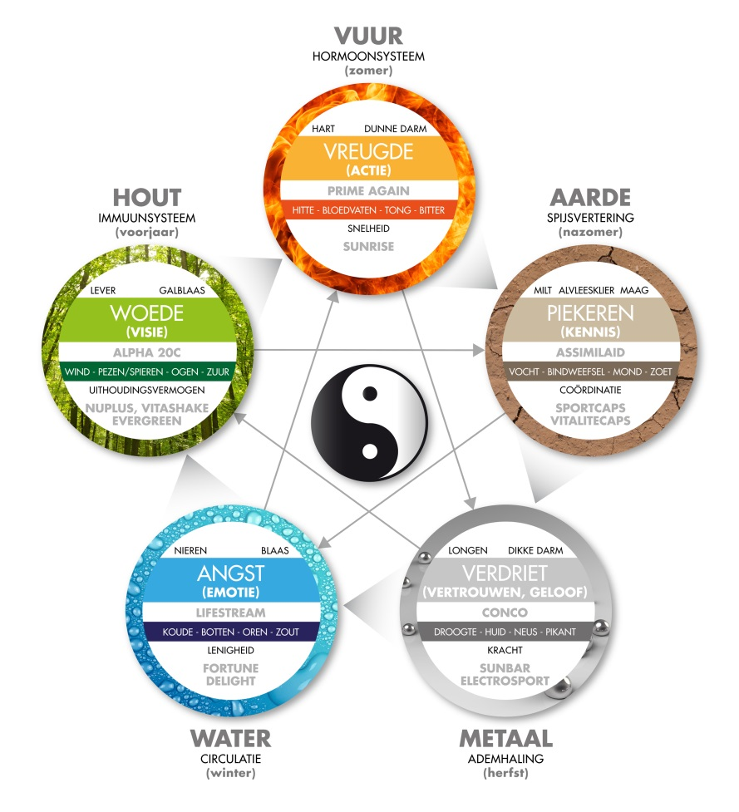
1. Voeden + Reinigen = Balans
VOEDEN + REINIGEN = BALANS
Sunrider producten voeden (yin) en reinigen (yang), zodat balans wordt bereikt voor een optimale gezondheid.
Voeden van de vijf elementen.

Slide 13
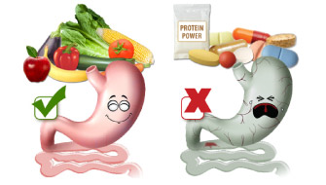
Voedingsmiddelen, geen Chemicaliën
VOEDINGSMIDDELEN
Ons lichaam herkent voedingsmiddelen, geen chemicaliën.
Van chemicaliën kan je geen voedsel maken, ze hebben geen levensstructuur.

Slide 14
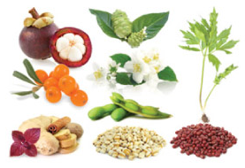
VARIËTEIT
Eén ingrediënt kan niet alles doen.
Teveel van één soort kan disbalans creëren.

Slide 15
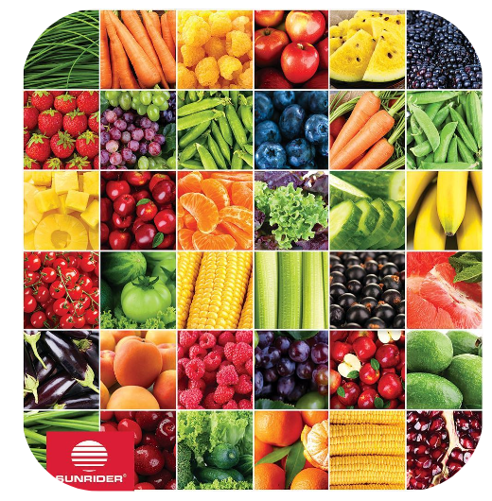
SUNRIDER = UNIEK
Voedingskruiden / niet medicinaal
Super geconcentreerd (10x)
Uitgebalanceerd
Geen gif, GMO, chemicaliën
Notes:
What makes these foods so valuable and UNIQUE to the marketplace?
Whole Foods - A whole food Is the Carbs, Proteins, Fats, Vitamins and Minerals ALL IN TACT,
NOTHING ADDED OR SUBTRACTED- except the water and the non-nutritive indigestible bulk. We couldn’t begin to eat all these herbs just as it is grown.
Food Grade Herbs - Herbs are a much higher nourishment than our beans and potatoes. But are tightly bound, so have to be carefully prepared to release that nourishment. This is so different than drying herbs, chopping them up and putting them in a capsule, where we get very little benefit..
Concentrated 8-10xs - Can you even imagine how much food you would have to eat to get the equivalent quantity of nutrition. How much would your groceries cost if you purchased 10x as much food. Concentration is critical for significant excellent health.
Properly combined to Nourish Systems - Not just a lot of wonderful foods put together, but very specific foods to restore the balance in each system. A balanced system is a healthy system.
Properly combined to negate weaknesses and bring out strengths. Every food has negatives and strengths….Dr. Chen, the master herbalist knows how to properly combine to do this. You can’t read this on a label. It’s the synergy of the combination.
These food grade herbs don’t interfere with meds - many people come to the SR lifestyle on many meds, slowly they are able to start dropping these as the body comes into balance.. No interference, these are foods. If the doctor says don’t eat food,, then you wouldn’t want to eat SR.
Safe for pregnant & nursing moms - this is SR safety criteria
Grown without pesticides, chemicals & GMO - grown naturally on mountain sides or in controlled pristine gardens, & farms. They are then cleaned 5 ways in Singapore before coming into the US. The FDA doesn’t require fumigation and irradiation of our herbs, unlike other herbs that come in to the US, because they are so clean. This is huge in maintaining that life and vitality of the herbs.!
Quality Control, Safety, and very Effective – These are SR’s Top Priorities - Because our standards are so high, the FDA has given Sunrider a Pharmaceutical Level of Manufacturing, unheard of for a food company.

Slide 16
SUNRIDER = UNIEK
Milieuvriendelijk
Baby safe
Farmaceutische normen
Notes:
What makes these foods so valuable and UNIQUE to the marketplace?
Whole Foods - A whole food Is the Carbs, Proteins, Fats, Vitamins and Minerals ALL IN TACT,
NOTHING ADDED OR SUBTRACTED- except the water and the non-nutritive indigestible bulk. We couldn’t begin to eat all these herbs just as it is grown.
Food Grade Herbs - Herbs are a much higher nourishment than our beans and potatoes. But are tightly bound, so have to be carefully prepared to release that nourishment. This is so different than drying herbs, chopping them up and putting them in a capsule, where we get very little benefit..
Concentrated 8-10xs - Can you even imagine how much food you would have to eat to get the equivalent quantity of nutrition. How much would your groceries cost if you purchased 10x as much food. Concentration is critical for significant excellent health.
Properly combined to Nourish Systems - Not just a lot of wonderful foods put together, but very specific foods to restore the balance in each system. A balanced system is a healthy system.
Properly combined to negate weaknesses and bring out strengths. Every food has negatives and strengths….Dr. Chen, the master herbalist knows how to properly combine to do this. You can’t read this on a label. It’s the synergy of the combination.
These food grade herbs don’t interfere with meds - many people come to the SR lifestyle on many meds, slowly they are able to start dropping these as the body comes into balance.. No interference, these are foods. If the doctor says don’t eat food,, then you wouldn’t want to eat SR.
Safe for pregnant & nursing moms - this is SR safety criteria
Grown without pesticides, chemicals & GMO - grown naturally on mountain sides or in controlled pristine gardens, & farms. They are then cleaned 5 ways in Singapore before coming into the US. The FDA doesn’t require fumigation and irradiation of our herbs, unlike other herbs that come in to the US, because they are so clean. This is huge in maintaining that life and vitality of the herbs.!
Quality Control, Safety, and very Effective – These are SR’s Top Priorities - Because our standards are so high, the FDA has given Sunrider a Pharmaceutical Level of Manufacturing, unheard of for a food company.

Slide 17
SUNRIDER = UNIEK
Synergetische werking (1 + 1 = 3)
Niet bestraald
Topkwaliteit, meer dan voeding
Notes:
What makes these foods so valuable and UNIQUE to the marketplace?
Whole Foods - A whole food Is the Carbs, Proteins, Fats, Vitamins and Minerals ALL IN TACT,
NOTHING ADDED OR SUBTRACTED- except the water and the non-nutritive indigestible bulk. We couldn’t begin to eat all these herbs just as it is grown.
Food Grade Herbs - Herbs are a much higher nourishment than our beans and potatoes. But are tightly bound, so have to be carefully prepared to release that nourishment. This is so different than drying herbs, chopping them up and putting them in a capsule, where we get very little benefit..
Concentrated 8-10xs - Can you even imagine how much food you would have to eat to get the equivalent quantity of nutrition. How much would your groceries cost if you purchased 10x as much food. Concentration is critical for significant excellent health.
Properly combined to Nourish Systems - Not just a lot of wonderful foods put together, but very specific foods to restore the balance in each system. A balanced system is a healthy system.
Properly combined to negate weaknesses and bring out strengths. Every food has negatives and strengths….Dr. Chen, the master herbalist knows how to properly combine to do this. You can’t read this on a label. It’s the synergy of the combination.
These food grade herbs don’t interfere with meds - many people come to the SR lifestyle on many meds, slowly they are able to start dropping these as the body comes into balance.. No interference, these are foods. If the doctor says don’t eat food,, then you wouldn’t want to eat SR.
Safe for pregnant & nursing moms - this is SR safety criteria
Grown without pesticides, chemicals & GMO - grown naturally on mountain sides or in controlled pristine gardens, & farms. They are then cleaned 5 ways in Singapore before coming into the US. The FDA doesn’t require fumigation and irradiation of our herbs, unlike other herbs that come in to the US, because they are so clean. This is huge in maintaining that life and vitality of the herbs.!
Quality Control, Safety, and very Effective – These are SR’s Top Priorities - Because our standards are so high, the FDA has given Sunrider a Pharmaceutical Level of Manufacturing, unheard of for a food company.

Slide 18
FAMILIEBEDRIJF | DESKUNDIG
Dr. Tei Fu Chen
Dr. Oi Lin Chen
Vijf kinderen
Notes:
Let me introduce to you The Chen Family
Dr. Tei Fu Chen
Pharmacologist & world-renowned Chinese Master Herbalist
Dr. Oi Lin Chen, his wife
CEO of SR, is a medical doctor; is one of Most Influential Women in Direct Marketing in the world
Together they lead a team of highly trained scientists
All 5 of their children are a significant part of SR as: Doctors, Lawyers, Chemistists, Computer Professionals

Slide 19
Hoeveel % van je lichaam
is in 1 jaar vernieuwd?

Slide 20
98% !

Slide 21
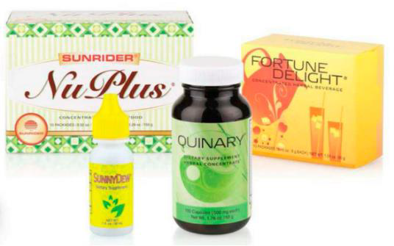
5 BASISPRODUCTEN
Nuplus
Quinary capsules
Calli
Fortune delight
Sunny dew
Notes:
Begin with the Basic 5
This is Herbal Intervention at its Best
This is where we encourage everyone to start.
These 5 are critical for regeneration
The Basic 5 products are
made up of 72 individual herbal whole foods
Powerfully & properly combined to
We Nourish-Balance_Cleanse our bodies at the cellular level.
These 5 foods we eat every day.
We love how we feel eating these foods and drinking these favorite beverages.
Yes, we still eat other foods,
but we do make better table choices
we eat less other food
and we feel so much better.

Slide 22
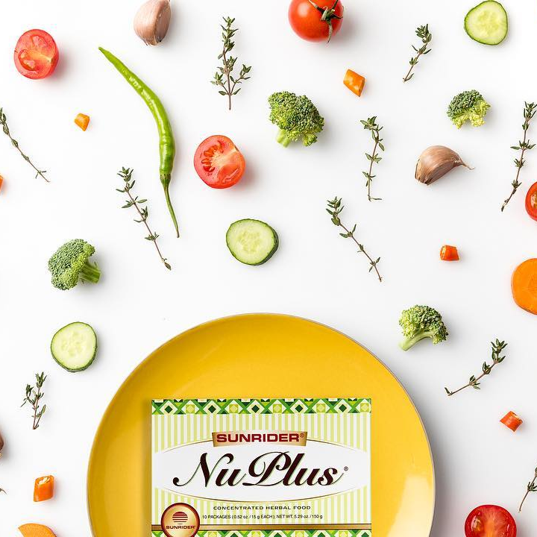
5 BASISPRODUCTEN
VOEDEN: NuPlus
Cel regeneratie
Hersenen, spieren, zenuwen enz.
Zwangerschap
Notes:
NOURISH: NuPlus
NuPlus nourishes the cells
To be stronger than the one just replaced
NuPlus is cellular regeneration
Brain cells, Muscle cells, Nerve cells, all cells!
We Could actually live on NuPlus - it is so properly combined!
12 whole foods in one pkg. for $2.00
This is great food for: Pregnant moms, Newborns, Kids, Millennials,
Executives, BodyBuilders, Elderly; the weak and the strong
Enjoy 1,2,3,4 packages or more a day-- you can’t eat too much.
The more you eat the better you feel.
$2.00 for 12 powerful foods!
From pregnancy on, Powerfully nourish with NuPlus,
Make that next cell in your body stronger than the one just replaced.
From pregnancy on….
Powerfully nourish at the cellular level with NuPlus

Slide 23
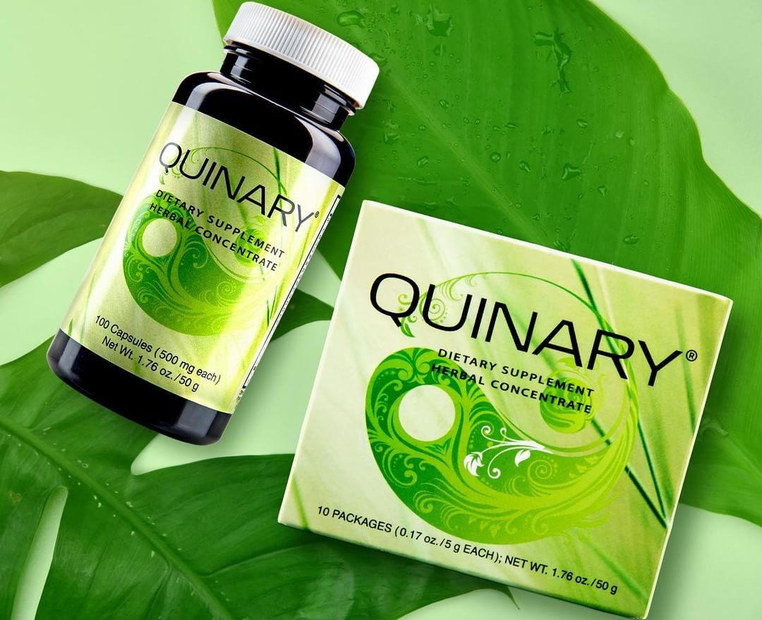
5 BASISPRODUCTEN
BALANS: Quinary
Balans in de vijf systemen:
- Spijsvertering
- Ademhaling
- Bloedsomloop
- Afweersysteem
- Hormoonsysteem
Notes:
2. BALANCE: QUINARY
Quinary uniquely restores balance
Got a symptom? It just means a system is out of balance.
With Quinary you are nourishing the
5 Life Support Systems in your body
Digestive
Respiratory
Circulatory
Glandular
Immune
Whether your system is overactive/underactive - restore the balance
A balanced system is a healthy system.
When one system is out of balance, all 5 suffer
That’s why we nourish all 5 at the same time.
You Can additionally nourish the weakest system even more if you choose - but start by nourishing all 5 with Quinary.
A Symptom is simply a system out of balance
Quinary is made up of 50 system-specific foods - Only $3.95 a pkg a pkg, equals 10 capsules
We love Quinary, in our breakfast smoothie, or as a night time tea...or enjoyed thru the day.
1,2,3,4 or more pkgs….you can’t eat too much! This is whole food!
But at least start with once a day.

Slide 24
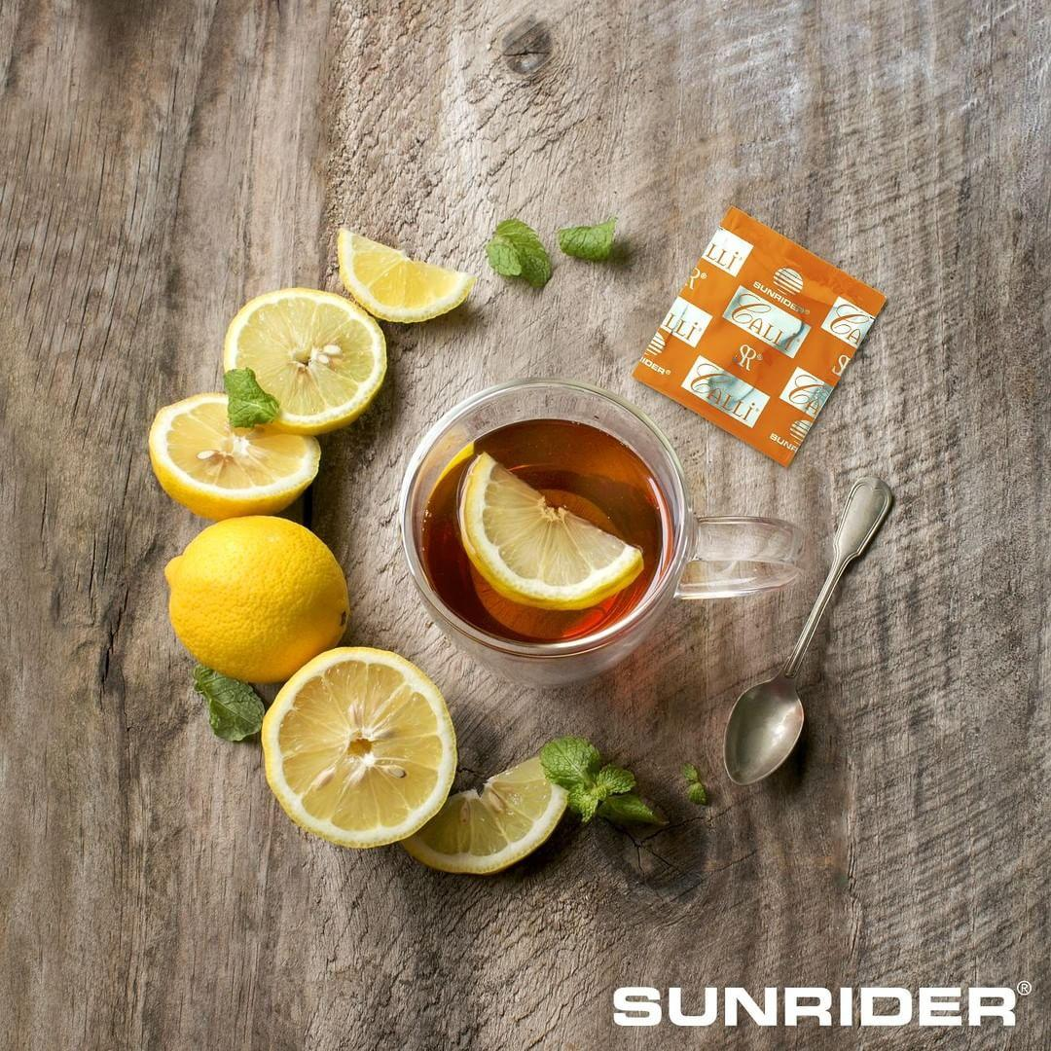
5 BASISPRODUCTEN
REINIGEN: Calli
Calli voedt de vijf reinigingsorganen:
- Lever
- Nieren
- Darmen
- Longen
- Huid
Meer helderheid
Notes:
3. CLEANSE: Calli:
Calli nourishes our 5 cleansing organs
Liver
Kidneys
Colon
Lungs
Skin
so THEY do their work more effectively
Calli, concentrated 8-10xs makes our water 10xs more effective
Calli is a natural delicious Daily detox
no stimulants, no stressful cleanses
1 pkg- tea bag - steeped in 8 cups of water. makes 8 delicious cups of Calli to enjoy drinking all day long
You gain that mental clarity, calm energy, vitaly health all thru the day
no need for stimulants to get the day going and for those slumps., and NO WITHDRAWLS.
Calli is 5 whole foods with the benefits of Green tea properly prepared and combined to not have the stimulating negataives plus 4 more wonderful herbs
for only $1.10 pkg. that 13 cents a cup.
Make your 8 cups stronger as time goes on with 1,2,3,4 or more pkgs of Callia day in your 8-12 cups water….it’s food, you can’t eat too much.
But at least start with 1 pkg. in 8 cups.

Slide 25
5 BASISPRODUCTEN
REINIGEN: Fortune Delight
Spijsverterings- stelsel
Anti-oxidanten
Voert vet af
Sportdrank
Hydraterend
Zuur uit spieren
Notes:
4. CLEANSE: ALSO WITH Fortune Delight
Fortune Delight cleanses SPECIFICALLY
Anything connected to the digestive system
Cleanses with powerful antioxidants
Flushes fat
You can add this to your Calli and enjoy thru the day
or make this instant beverage in 1 quart of water
or add to your smoothies or even out of the pkg.
5 foods again for $1.00 / 1 quart
Also a great sport drink
Super hydrating,
helps you handle heat and cold
helps you hold onto your electrolytes when exercising
Removes acid buildup in muscles- so goodbye sore muscles.
So many people struggle with sodas & sport drinks
The need and for these drinks quietly disappears, no withdrawls
You feel sooooo much better!
Nothing satisfies thirst like Fortune Delight!

Slide 26
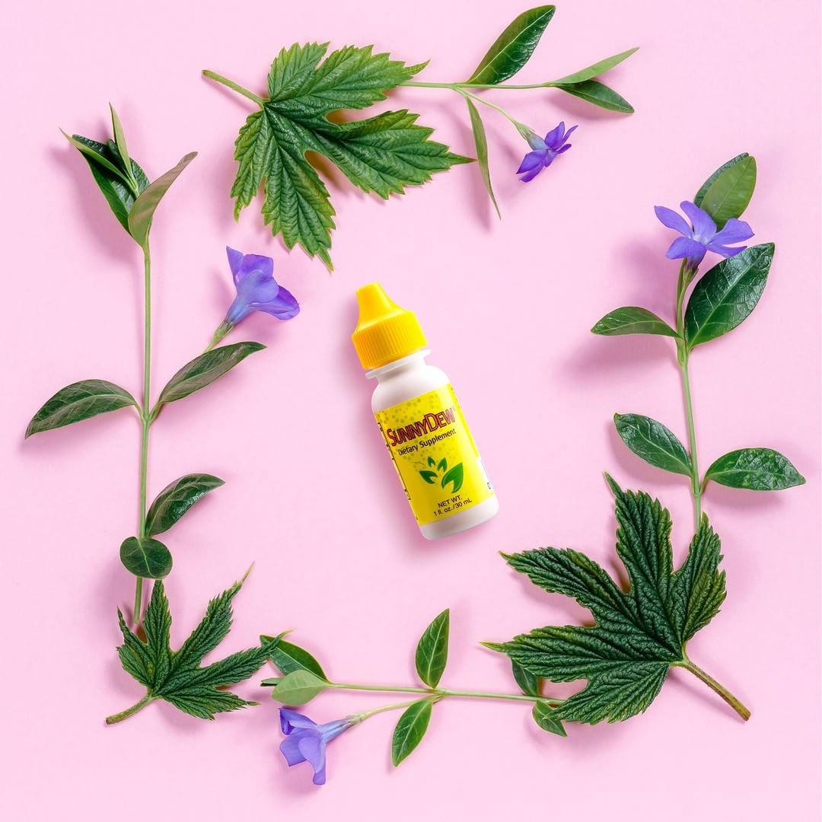
5 BASISPRODUCTEN
GEZOND ZOET: Sunny Dew
Ondersteunt bloedsuikerspiegel
- Tegen schimmel
- Tegen virussen
- Tegen tandbederf
- Tegen ontstekingen
Totaalvoeding
Notes:
5. Finally the icing on the cake:
A Wonderful, very healthy sweet!
SunnyDew
Comes from 2 wonderful herbs:
Stevia
Chrysanthemum
These amazing delicious little drops of Sunnydew give support to our Blood sugar and blood pressure
They are also
antifungal
antiviral
anti-tooth decay
anti-inflammatory
People rave all the time that Sunnydew is the
Best tasting stevia on market
Makes everything taste great
Totally nourishing
A must in every kitchen
I love it in my beverages, my smoothies, in anything

Slide 27
GEZOND NAAR 100
Vitaal & gezond

Slide 28
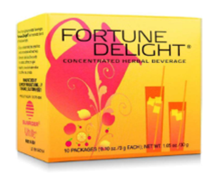
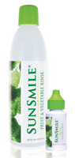
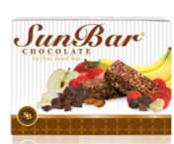
PRODUCTEN ERVAREN
NuPlus
FORTUNE DELIGHT
SunBreeze Oil
SunBar
Groente- en fruit-spoeling
CALLI

Slide 29
ERVARING VAN ANDEREN

Slide 30
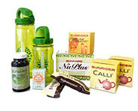
PRODUCTEN BESTELLEN
€ 108,00 (ex BTW) investering (aan producten)
€ 54,00 (ex BTW) jaarlijkse bijdrage
10% korting
Deel met anderen – genereer Cash Flow
KLANT - Gratis - Klantenprijs
VOORKEURS-KLANT - jaarbijdrage 27 euro - 5% korting op producten - 10% korting op Autoship
IBO (Independent Business Owner) - jaarbijdrage 54 euro - 10% korting op producten - productinvestering 108 euro - deel met anderen: genereer cash flow
Notes:
3 Great Accounts to Choose From: Your choice!
Customer:
FREE - Retail
Preferred Customer:
$30 annual fee
Shop 5%
Autoship - 10%
IBO (Business Owner)
$120 Open Account ($60 products)
$59 annual fee
Shop 10%
Share with Others - Cash Flow
(Only For additional info:
Customer Account
Free
Shop Retail
Preferred Customer
$30 yearly fee (shop $200 within 30 days of renewal - fee waived)
Shop 5% discount
Convenient with 10% Shopping Discount - Monthly autoship $200+
“Happy Consumer”
IBO - Independent Business Owner
$120 “Open your Business” (includes $60 product 1st time)
$59 yearly renewal fee
Shop 10% discount & also convenient autoship 10%
We own our own business & we leverage our time
Have our foods paid for and make money too
In business for ourselves not by ourselves-excellent mentoring
NO MONTHLY REQUIREMENTS ON ANY OF THE ACCOUNTS!

Slide 31
IBO – Eigen bedrijf
Zelf al vijfentwintig jaar
Delen producten
Voordelen
Extra cashflow
Anderen helpen gezonder te leven, meer vitaliteit te ervaren en beter in je lijf te zitten.
Notes:
What are some of the Early Signs of Regeneration
Most people are looking for their big challenge to start going away
Because regeneration is subtle new SR’s often miss some of the early signs of regeneration.
It gives us courage that the body is becoming stronger when we notice the early signs of regeneration:
More Mental Clarity
More Calm Energy
Sleeping Better
Increased overall well being

Slide 32
MEEGENOMEN
REGENERATIEPAKKETTEN:
10-daags pakket
Maandpakket
Prijzen: zie formulieren
Bij maandpakket: gratis coaching
Vragen? Meer informatie? Stel ze gerust!

Slide 33
GEZOND NAAR 100
Notes:
IF USING 3 MINUTE VIDEO
Thank you for watching the 3 minute introduction to Healthy Till 100. It’s an honor to be with you here today.
My name is Donna Ehrlich and my good friend Paul Jensen asked me to share the secrets of Healthy Till 100 and what has powered this simple and enjoyable life of living Healthy Till 100
We may not all live all the way to 100
but we can strive to live well as long as we do live….
radiating health
an abundant lifestyle
an unselfish heart
and a desire to serve
This presentation is for you, and how we can help you, meet YOUR goals...
to help you live an abundant life as long as you live.
NO 3 MINUTE PRESENTATION
It’s an honor to share with you the Healthy till 100 Lifestyle.
My name is Donna Ehrlich and our family is definitely living the Healthy till 100 Lifestyle
and we are loving it.
We may not all live all the way to 100
but we can strive to live well as long as we do live….
radiating health
an abundant lifestyle
an unselfish heart
and a desire to serve
This presentation is for you, and how we can help you, meet YOUR goals...
to help you live an abundant life as long as you live.

